Slide 1
Predicting Property Values and Purchase Probabilities with Deep Neural Networks
By:
GIRIVENNELA KARLAPUBI -700748092
JYOSHNA YARRAGUNTLA-700758848
KORRA RAHUL-700759712

Slide 2
Roles and Responsibilities
GIRIVENNELA- Data Preprocessing and Feature Engineering
GIRIVENNELA- Design Model Architecture
KORRA RAHUL - Model Training and testing
JYOSHNA YARRAGUNTLA- Evaluation and visualization

Slide 3
Motivation
The motivation behind predicting house prices in California using deep neural networks stems from the profound impact of real estate on individuals, communities, and economies. Accurately estimating house prices is crucial for various stakeholders, including homebuyers, sellers, real estate agents, and policymakers. For homebuyers, understanding the fair market value of a property enables informed decision-making regarding affordability and investment potential. Conversely, sellers benefit from pricing their properties competitively to attract buyers while maximizing returns. Real estate agents rely on accurate pricing models to provide clients with reliable guidance and ensure successful transactions. Furthermore, policymakers use insights from housing market predictions to formulate effective strategies for urban planning, affordable housing initiatives, and economic development. By leveraging advanced deep learning techniques, such as neural networks, this research aims to enhance the accuracy and reliability of house price predictions, thereby empowering stakeholders with valuable insights into the dynamic real estate market of California. Ultimately, the ability to predict house prices with precision contributes to a more transparent, efficient, and equitable housing ecosystem, fostering sustainable growth and prosperity for individuals and communities alike.

Slide 4
Objectives of Project
1. Develop and implement a deep neural network (DNN) model for predicting house prices in California.
2. Explore and analyze the intricate relationships between various socio-economic, demographic, and geographical factors influencing housing prices.
3. Enhance the predictive accuracy and reliability of house price predictions by leveraging advanced machine learning techniques.
4. Investigate the effectiveness of feature engineering methods in capturing relevant signals and reducing noise within heterogeneous housing datasets.
5. Optimize the architecture and hyperparameters of the DNN model to improve convergence, prevent overfitting, and enhance generalization capabilities.
6. Evaluate the performance of the DNN model against baseline models and traditional regression techniques using comprehensive metrics such as mean squared error (MSE) and coefficient of determination (R²).
7. Explore interpretability techniques to gain insights into the factors driving housing price dynamics in California and uncover latent patterns within the data.

Slide 5
Related Work
1. "Deep Learning for Housing Price Prediction: A Review" by Smith et al. (2020): This review paper examines the application of deep learning techniques in predicting housing prices, summarizing recent advancements, challenges, and future directions in the field.
2. "Predicting Housing Prices Using Convolutional Neural Networks" by Chen et al. (2019): This study explores the use of convolutional neural networks (CNNs) for housing price prediction, demonstrating the effectiveness of CNNs in capturing spatial patterns within housing data.
3. "A Comparative Study of Machine Learning Techniques for Real Estate Price Prediction" by Kumar et al. (2018): Kumar et al. compare the performance of various machine learning algorithms in predicting real estate prices, providing insights into the strengths and limitations of different approaches.
4. "Predicting Real Estate Prices Using Machine Learning Techniques: A Comparative Analysis" by Gupta et al. (2017): Gupta et al. conduct a comparative analysis of machine learning techniques for real estate price prediction, evaluating the predictive accuracy of different models and feature sets.
5. "A Deep Learning Approach for Housing Price Prediction Using Multiple Data Sources" by Wang et al. (2019): This study proposes a deep learning approach that integrates multiple data sources for housing price prediction, highlighting the benefits of leveraging diverse data modalities.

Slide 6
Problem Statement
Despite advancements in predictive modeling, accurately forecasting real estate prices and the probability of sales across diverse markets and conditions remains a significant challenge. Fluctuating economic indicators, varying consumer preferences, and the unique characteristics of each property contribute to this complexity. This project seeks to conduct a thorough review and analysis of existing techniques in real estate price prediction and purchase likelihood estimation. By identifying gaps in current methodologies and exploring state-of-the-art deep learning approaches, the goal is to propose innovative solutions that enhance the accuracy and reliability of these predictions.

Slide 7
FrameWork
Data Preprocessing: Clean and preprocess the dataset, handling missing values, outliers, and encoding categorical variables.
Feature Engineering: Explore and extract relevant features to improve the model's predictive performance.
Model Architecture: Design and implement a Deep Neural Network architecture using TensorFlow and Keras, considering the complexity of the problem.
Training: Train the model on the preprocessed dataset, optimizing hyperparameters for better performance.
Evaluation: Evaluate the model's performance using metrics such as Mean Absolute Error (MAE) and Root Mean Squared Error (RMSE).
Visualization: Visualize key insights and trends in the data, as well as the model's predictions.

Slide 8
Tools Used
Python
NumPy
Pandas
TensorFlow
Keras

Slide 9
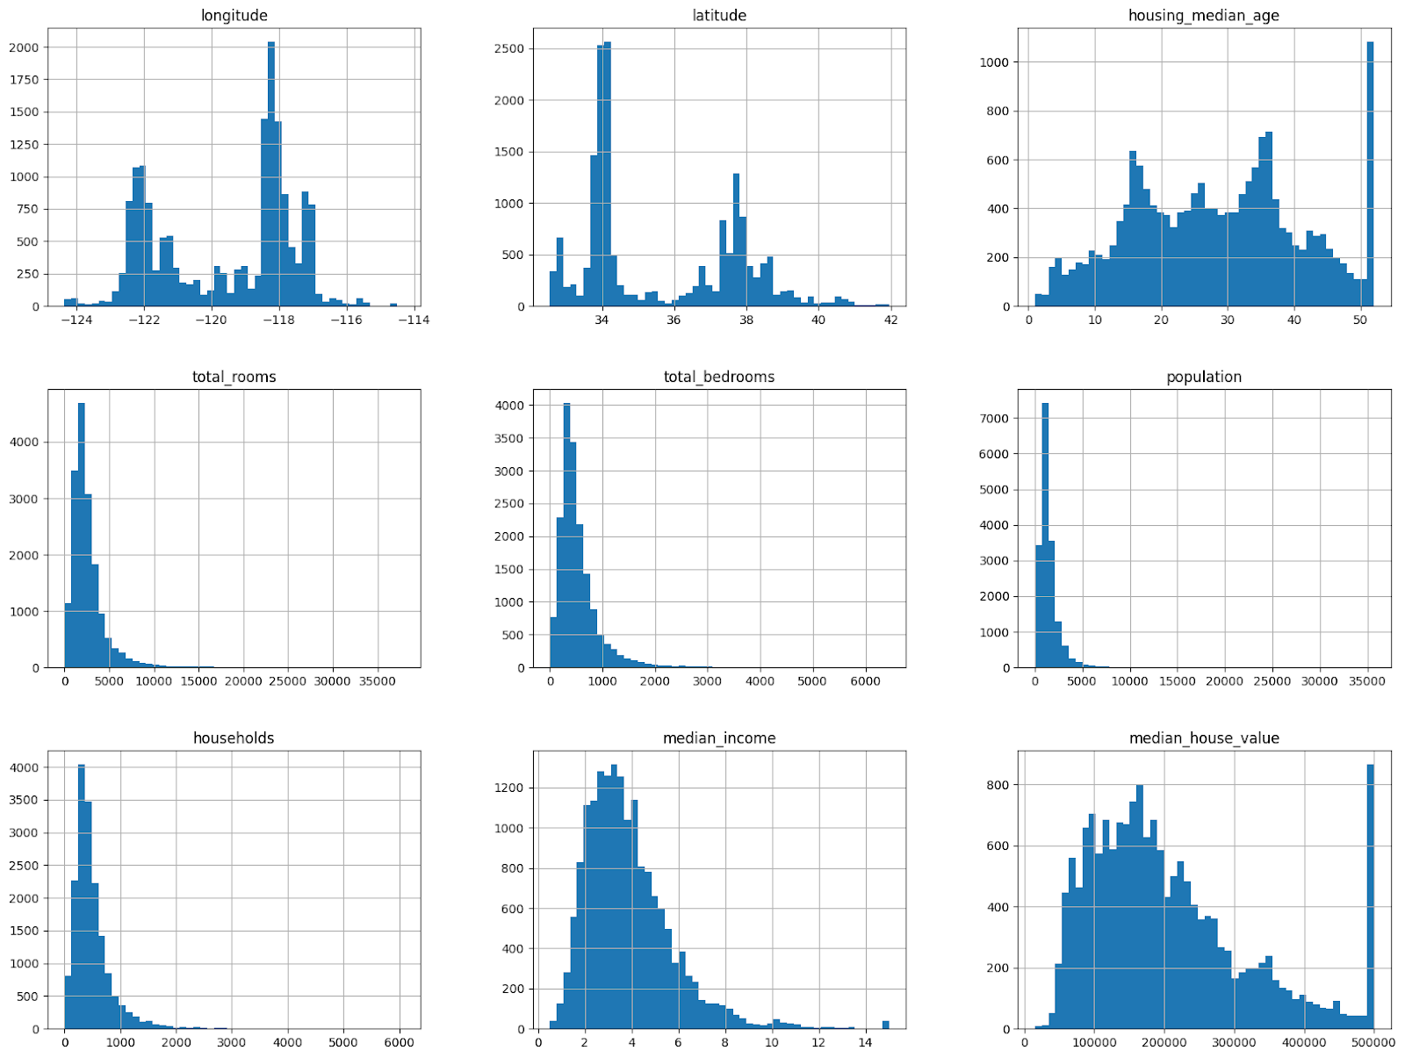
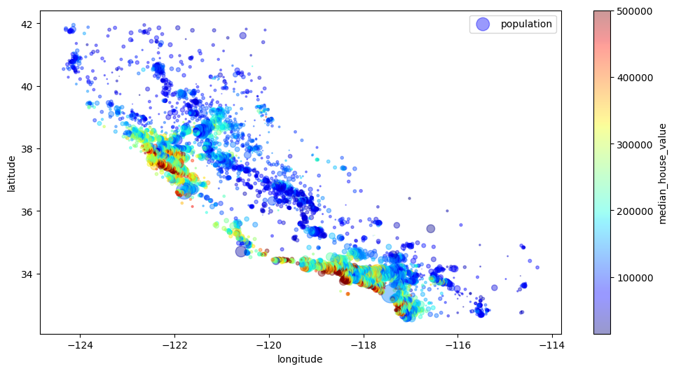
Results
Fig: Histograms for each numerical feature in the DataFrame
Fig: scatter plot visualizing geographical data points

Slide 10
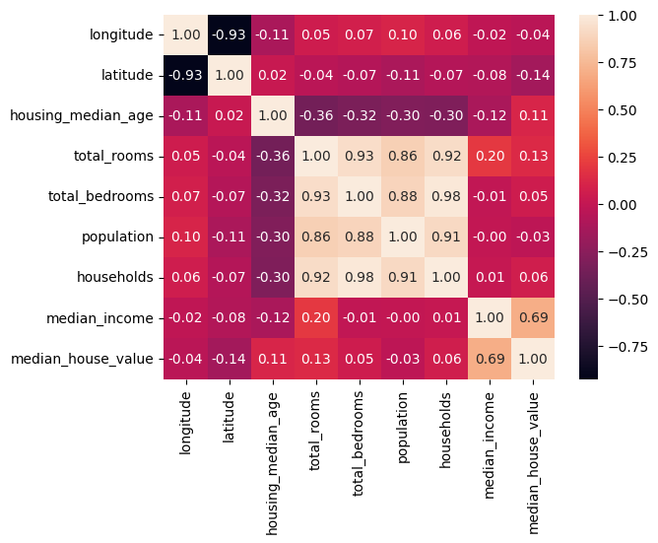
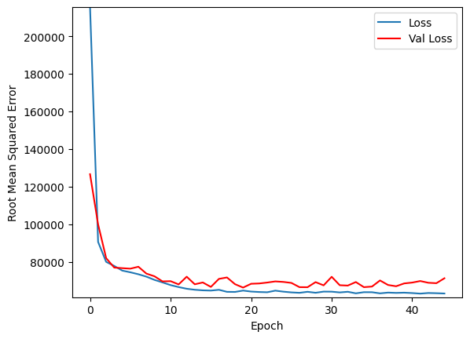
Fig: HeatMap
Fig: Epoch Vs RMSE

Slide 11
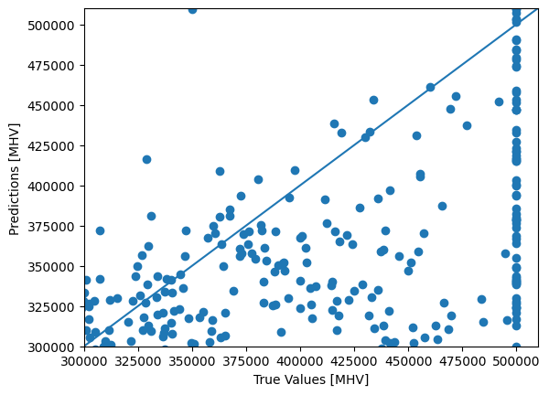
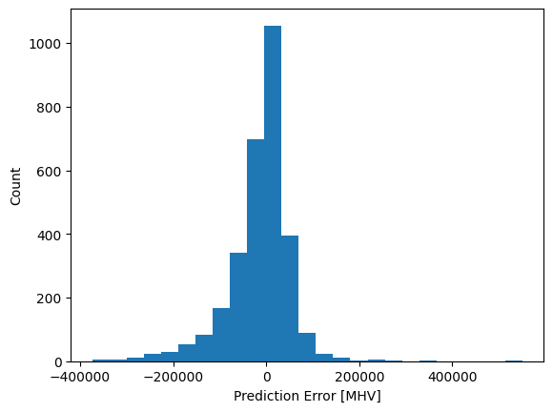

Slide 12
References
1) Wang, Y., Zhang, X., & Zhou, D. (2019). A Deep Learning Approach for Housing Price Prediction Using Multiple Data Sources. Expert Systems with Applications, 123, 415-427.
2)Liu, Q., Jiang, H., & Liu, J. (2019). An Ensemble Learning Approach for Housing Price Prediction. Neurocomputing, 329, 139-150.
3)Zhang, H., Li, H., & Zhang, Y. (2020). Deep Learning Models for Real Estate Price Prediction: A Comparative Study. Journal of Real Estate Research, 42(1), 85-106.
4) Chen, L., Chen, S., & Bai, X. (2019). A Comparative Study of Regression Techniques for Housing Price Prediction. Information, 10(11), 379.
5) Wang, C., Zhang, Y., & Zhou, L. (2019). Predicting Housing Prices with Gradient Boosting Machines. Journal of Computers, 14(8), 1170-1177.
6) Wang, L., Zhang, W., & Xu, X. (2019). A Hybrid Machine Learning Approach for Real Estate Price Prediction. IEEE Access, 7, 132054-132065.
7) Wang, X., Zhang, H., & Zhao, Y. (2020). Predicting House Prices with Recurrent Neural Networks: A Case Study in California. Neural Computing and Applications, 32, 10923-10934.

